Slide 1
OC Procurement Alliance
Kick-Off Meeting
County Conference Center
County Administration South
March 16, 2022
Notes:
Type your notes

Slide 2
Agenda
I. Networking
II. Introduction
III. County Vision for Alliance
IV. OC Procurement Alliance / CoProcure Unveiling
V. Cooperative / Collaborative Procurement
VI. Network - Group Activity
VII. Training / Compliance
VIII. Vendor Outreach
IX. Next Steps
X. Frequency of Meetings
Notes:
Type your notes

Slide 3
Welcome
Round Table Introductions
Name
Organization
What is your organization hoping to gain from Alliance?
Notes:
Type your notes

Slide 4
Collaborative Success Stories
Saving Millions $$$
Baltimore Regional Cooperative Purchasing Committee
Cook County, Illinois (Chicago City-County Collaboration)
over $25M savings in first years
Kansas City Regional Purchasing Cooperative
Tarrant County, Texas
over 100 cities/towns/gov’t participants
State of Arizona Strategic Alliance for Volume Expenditures (S.A.V.E.)
Greater Portland Council of Governments
Notes:
Type your notes

Slide 5
Vision for Alliance
Leverage market power to negotiate better terms, including lower prices
Industry standard savings of 5-15%
OC spend >$2B with just 5% savings = $50M savings
Increase efficiencies, eliminating duplication of efforts
Solicitation Costs for Board Awarded Contracts
RFP - $50K (6-24 months)
IFB - $27K
Provide local small businesses with increased opportunities to bid for local government contracts
Sharing of knowledge, information and expertise
Notes:
Type your notes

Slide 6
OC Procurement Alliance /
Co Procure Partnership
OC Board of Supervisors Kicked Off Efforts
CAPPO Conference
CoProcure Unveiling of New Alliance Platform
Notes:
Type your notes

Slide 7
Cooperative Procurement
Cooperative Procurement – National and local cooperative contracting entities and government entities that include cooperative language in their contracts to allow other member agencies to purchase contracted goods and services under the same pricing, terms and conditions as the contracting entity.
Notes:
Type your notes

Slide 8
Additional Terms and Conditions
ADDITIONAL TERMS AND CONDITIONS
Paragraph # 74A Last Revision: 03/01/22
Cooperative Contract
===============================================================================================================================
This Contract is a cooperative contract and may be utilized by all County of Orange departments.
The provisions and pricing of this Contract will be extended to other governmental entities. Governmental entities wishing to use this Contract will be responsible for issuing their own purchase documents, providing for their own acceptance, and making any subsequent payments. Contractor shall be required to include in any subordinate contract entered into with another governmental entity pursuant to this Contract, a contract clause that will hold harmless the County of Orange from all claims, demands, actions or causes of actions of every kind resulting directly or indirectly, arising out of, or in any way connected with the use of this Contract. Failure to do so will be considered a material breach of this Contract and grounds for immediate Contract termination. Governmental entities are responsible for obtaining all certificates of insurance, endorsements and bonds required. The Parties agree that any other governmental entity utilizing this Contract shall not be deemed to be an agent or employee of County for any purpose whatsoever. The Contractor is responsible for providing each governmental entity a copy of this Contract upon request. The County of Orange makes no guarantee of usage by other users of this Contract.
The Contractor shall be required to maintain a list of the County of Orange departments and governmental entities using this Contract. The list shall report dollar volumes spent annually and shall be provided on an annual basis to the County, at the County’s request.
Subordinate contracts must be executed prior to the expiration or earlier termination of this Contract and may survive the expiration of this Contract up to a maximum of one year; however, in no case shall a subordinate contract exceed five (5) years in duration.
Notes:
Type your notes

Slide 9
Collaborative Procurement
Governments within a region are aggregating their buying power and saving administrative time and effort by collaborating on joint solicitations
Ability to procure collaboratively for local specific needs
Vehicles
Homeless Services
Construction and AE
Information and Communications Technology
Office Solutions
Ability to focus on local and disadvantaged business community
Notes:
Type your notes

Slide 10
County Procurement Programs
County Deputy Procurement Agents Program
NIGP Training (10 Hours)
Deputization Exam (retest at 2 years)
Annual Training Requirements
Procurement Professional Program
Annual Training
Certification
Mentoring
Networking
Biannual Compliance Reviews
Notes:
Type your notes

Slide 11
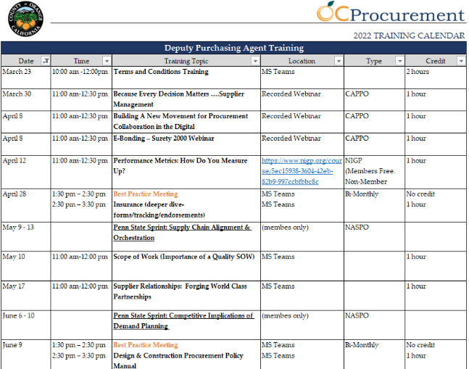
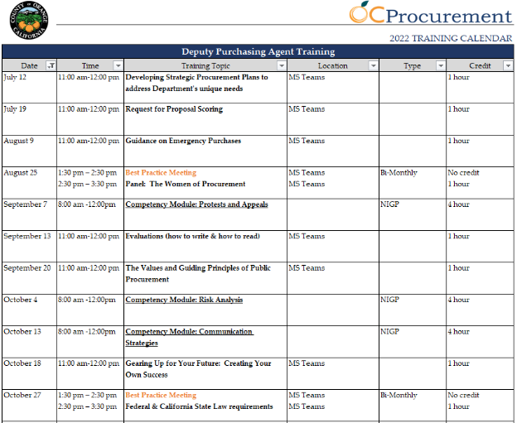
Training Calendar
Notes:
Type your notes

Slide 12
County Procurement Programs
County Preference Program
Disabled Veteran Business Enterprise (DVBE)
Local Small Business (LSB)
Vendor Outreach Program
Vendor Information Day
Association / Trade Organization Events
Vendor Outreach Networking Event
Thursday, May 19th
Vendors / Agencies Showcase Walk Through
Food Trucks
Notes:
Type your notes

Slide 13
Vendor Outreach Networking Event
Notes:
Type your notes

Slide 14
Next Steps
Next Steps
Data Sharing
Pilot Collaborative Procurements
(Open Forum)
Notes:
Type your notes

Slide 15
Next Steps
Frequency of Meetings / Location
July, November, March
Rotating Locations
Notes:
Type your notes

Slide 16
Thank You!
Notes:
Type your notes

